Slide 1
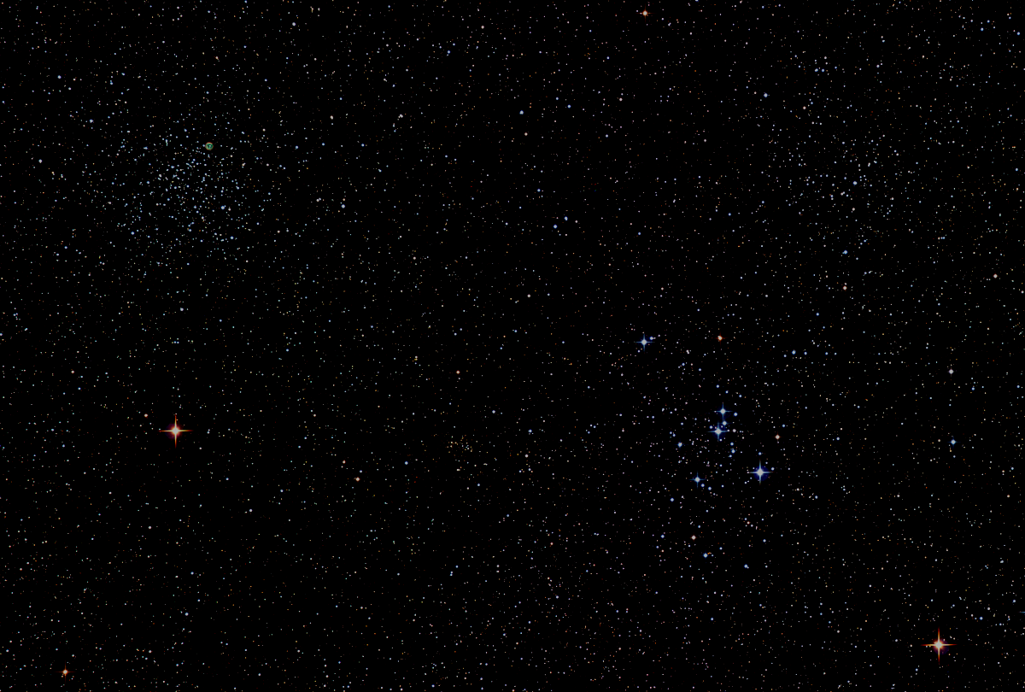


Howard
Astronomical
League
20
December 17, 2020
Notes:
Howard Astronomical League, February 20, 2020

Slide 2
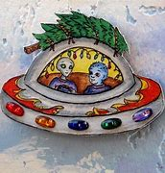

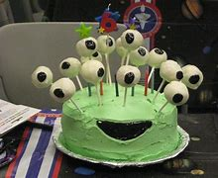
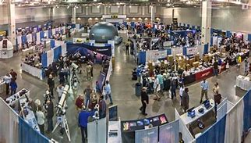
Welcome
HAL HOLIDAY PARTY
VIRTUAL

Slide 3
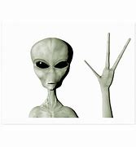


Welcome New Members and Guests

Slide 4
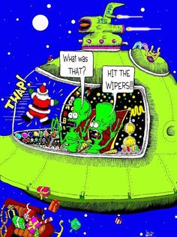
Astro Humor
Happy Holiday’s

Slide 5
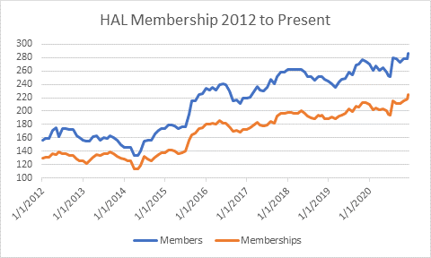
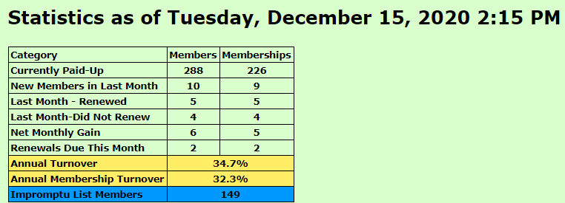
HAL Membership
All time HIGH

Slide 6
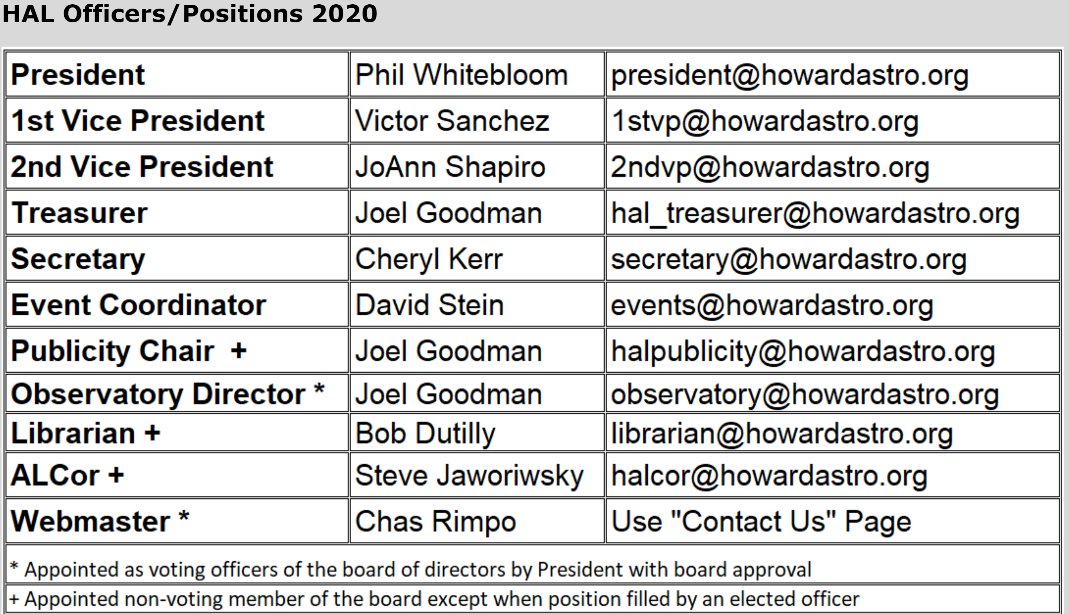
HAL OFFICERS

Slide 7
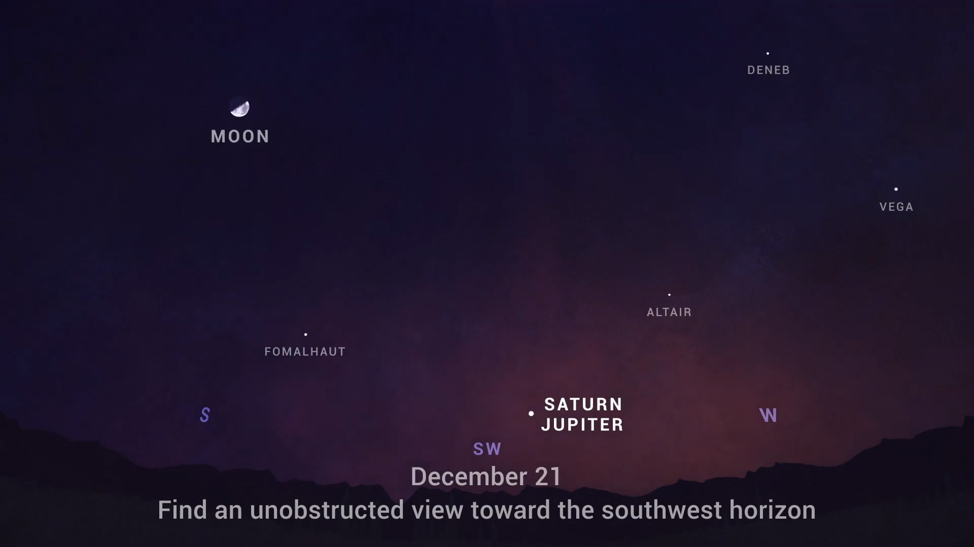
The ‘Great’ Conjunction of Jupiter and Saturn

Slide 8
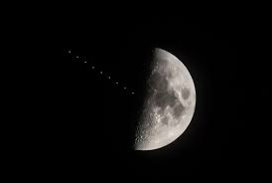
How to spot Santa Clause
Dec 24th, 2020
Exact time TBD

Slide 9

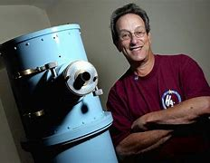
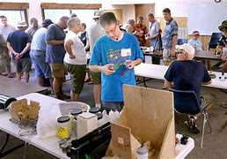
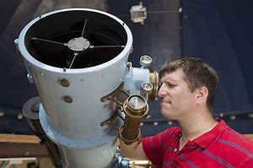
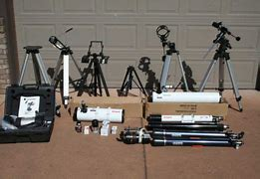
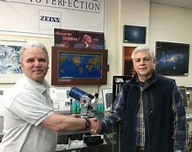
HAL Holiday Swap Meet

Slide 10
Impromptu Star Parties
Alpha Ridge is open for a keyholder to call an Impromptu with the following provisions:
1) HALO will remain closed, except to the keyholder to turn off/on the parking lot and restroom lights and to turn on power to the exterior SE corner of HALO.
2) The restrooms will not be unlocked. If they are left unlocked by the County, they are not to be used.
3) The keyholder is responsible for closing the gate after entering and keeping lock separately until locking up at the end of the observing session.
4) Members will be informed that the gate is being left closed except for entry and exit. Members will be asked to open the gate inwards and close the gate behind them upon arrival and to repeat the routine upon departure.
5) Members will be reminded that all social distancing protocols currently called for in Howard County will be in effect.

Slide 11
Thanks To All of You
Have the Happiest of Holidays
And may your 2021 be safe, healthy, prosperous, and filled with clear skies!

